Slide 1
Plugin Name: SpyderScience.Nop.Plugins.DeliveryAppSettings
This plugin is about Custom Settings for vendor and delivery boys
On admin page, there will be link “Custom Settings”
Once clicked, there will be three links in the dropdown:
Vendor Types
Vendor Settings
Delivery Settings
In ACL settings, there will be an option that tells which customer roles will be able to access Vendor Types, Vendor Settings and Delivery Settings pages. The Custom Settings link will be hidden for those who cannot access any of these pages.

Slide 2
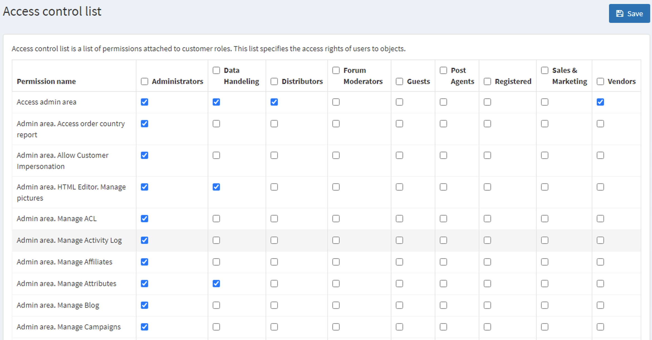
In ACL settings, five permission names will be added:
Drivers Settings: With this permission, Customer can see Drivers settings page.
Vendor Types page: With this permission, customer can see Vendor Type page.
Vendor Settings and Parameter Settings: With this permission, customer can see Vendor Settings and Parameter Settings pages.
Earning Settings: With this permission, customer can see Earning Settings and Earning Parameter Settings pages.
Delivery Boys Manager: With this permission, customer can see Delivery Orders page, Delivery Orders Detail and the pop-up (Choose Delivery Driver) to assign delivery (see on page 9).
Delivery Boys: With this permission, Customer will be able to see Delivery Orders page and Delivery Orders Detail page. Also he can assign / unassign the delivery to himself. He can only see his own deliveries or the deliveries that are not assigned to any driver.

Slide 3
VENDOR TYPES

Slide 4
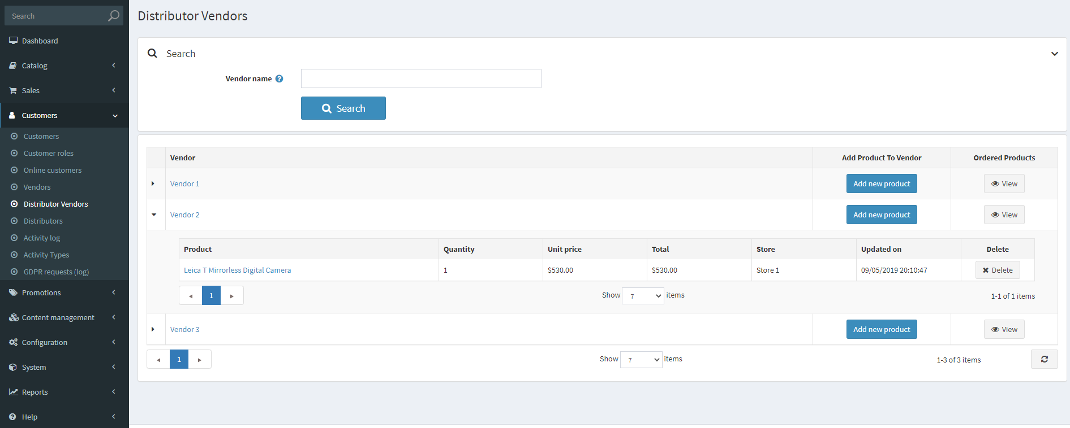
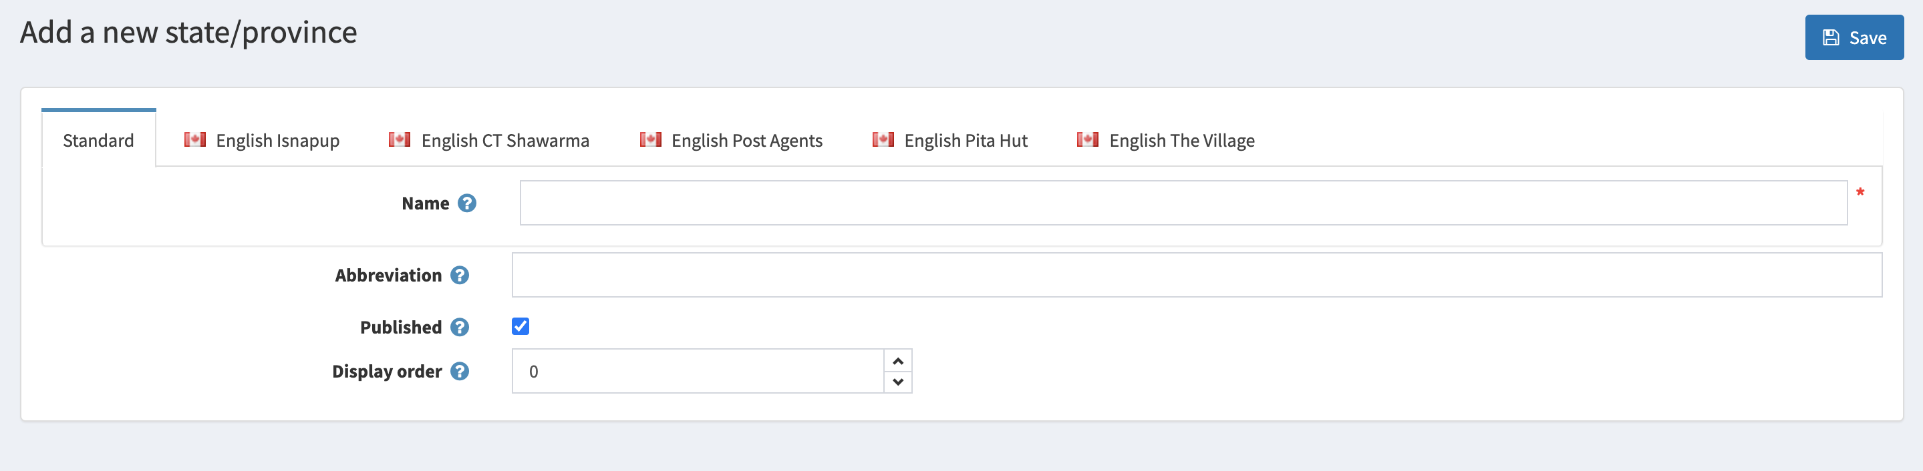
VENDOR TYPES
This is a new page and named Vendor Types.
This is a new database table that will make new vendor types. The 1st table will define the VendorTypes. The second table is a mapping between VendorTypeId and VendorId.
Vendor Types
Vendor Type
Vendor Types
Types
Published
Details
Vendors
Vendor Type 1
Edit
Add
Vendor Type 2
Edit
Add
Vendor Type 3
Edit
Add
Add a new Vendor Type
Description
Add new Vendor Type
Id | VendorType | Description | DisplayOrder | Published
1 | Type1 |  |  | 1
2 | Type2 |  |  | 1
3 | Type3 |  |  | 0

Slide 5
VENDOR SETTINGS

Slide 6
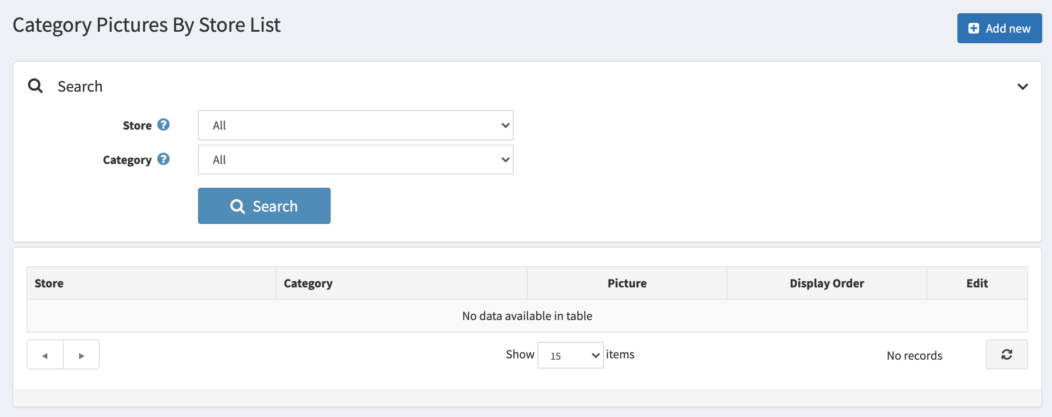
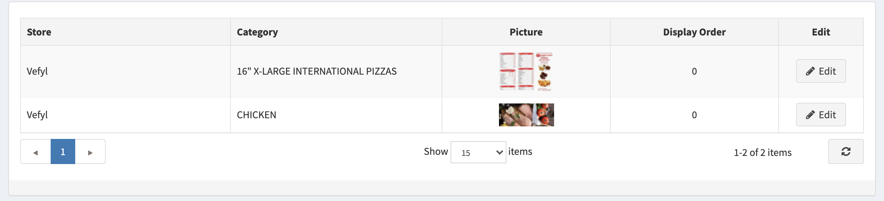
Vendor Settings
Vendor Type
Store Name
Vendors Details
Vendor Name
Limited To Stores
Vendor Types
Display Order
Order Preparation time
Vendor Profit Ratio
Edit
Vendor1
Store2
VendorType1,
VendorType2
Integer value
Float value
0
Vendor4
Store8
VendorType2
1
Integer value
Float value
Id | VendorId | LimitedToStores | VendorTypesId | OrderPreparationTime | VendorProfitRatio | DisplayOrder
1 | 21 | Store1;Store2 | 1;2;3; | 25 | 0.1 | 0
2 | 12 | Store1 | 3 | 23 | 0.15 | 1
3 | 5 | Store3 | 2;3 | 35 | 0.1 | 2

Slide 7

Vendors Parameter Settings – Vendor1
Save
Store Name
Store3
Warehouse
Warehouse1
Vendor
Vendor4
Order Preparation Time
Vendor Profit Ratio (VPR)
Value from 0 to 1
In minutes
Display Order

Slide 8
EARNING SETTINGS

Slide 9

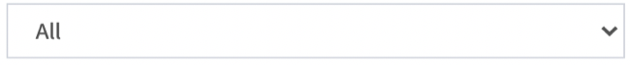
Earnings Settings
Customer name
Store Name
Vendor Name
Warehouse Name
Vendors Details
Order #
Products Cost Incl. Tax
(without checkout attributes)
Delivery Charges
Vendor Profit Ratio Effect
Checkout Attributes Amount
Total Earnings
Distance
Driver Earnings
Company Profit
12323
35.54
5.15
3.554
2
8.7
7.8
6.7
2
24532
46.23
7
6.9345
2
12.34
11.9
9.34
3
Id | OrderId | CheckoutAttributesAmount | VendorProfitRatioEffect | TotalDriverEarnings | CompanyMargin | TotalEarnings | NumberOfVendors | NumberOfWarehouses | NumberOfItems
1 | 23 | 2 | 5.499 | 7 | 11.499 | 18.499 | 2 | 3 | 10
2 | 43 | 7 | 5.1435 | 9 | 6 | 15 | 1 | 1 | 4

Slide 10
Earnings Parameter Settings
Save
Delivery Charges Constant (DC0)
Used in Driver Earnings [Driver Earnings] = [DC0]*[DELIVERY CHARGES] + [CheckoutAttributesAmount] – [ServiceCharges]
Distance Constant (D0)
Used in Condition: [Driver Earnings]/[DistanceBetweenWarehouseAndShippingAddress] < [D0]
Order Delay Charges (ODC)

Slide 11
DRIVER SETTINGS

Slide 12


Driver Settings
First Name
License #
Last Name
Insurance #
Username
Phone #
Vendors Details
Customer Roles
Name
Username
Phone
Email
Earnings last week
Deliveries last week
Active
Last Activity
Edit
Asdfas sfsd
dsfsf
213412312
A@fb.s
450
60
02/06/2021 21:00:28
Adsfd sdf
asdfsa
1121221323
fr@ds.ca
325
45
02/06/2021 21:00:28
Checkout Attributes Visibility
Check the attributes that will be visible to driver:
Checkout Attribute Name 1:
Checkout Attribute Name 2:
Checkout Attribute Name 3:

Slide 13

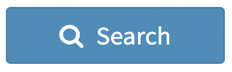
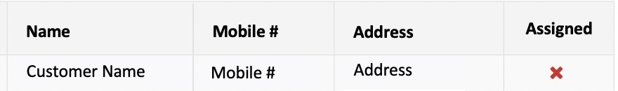

Driver
Choose Customer
Driver info
Vehicle License *:
Vehicle Type
License #
Vehicle plate #
Vehicle Insurance #
Work Authorization Details *:
Social Insurance Number / National ID #
Background Check Status
Bank Account Details *:
Bank Name
Bank Account Type (Chequing or Saving)
Institution #
Branch ID
Account #
Bank Address line 1
Bank Address line 2
Country (should be same as profile info)
State / Province
City
Zip / Postal Code

Slide 14
Edit Driver– Customer Name
Choose Customer
Driver info comes when we choose a customer and press the save button
Driver info
Vehicle License *:
Vehicle Type
License #
Vehicle plate #
Vehicle Insurance #
Work Authorization Details *:
THIS NEEDS TO BE verified external websites for background checks like https://checkr.com/
Social Insurance Number / National ID #
Background Check Status
Verify Externally
Bank Account Details *:
Bank Name
Bank Account Type (Chequing or Saving)
Institution #
Branch ID
Account #
Bank Address line 1
Bank Address line 2
Country (should be same as profile info)
State / Province
City
Zip / Postal Code

Slide 15
Edit Driver– Customer Name
Earning details
Shipment# | Order# | TrackingNumber | Warehouse | DateShipped | DateDelivered | NumberOf Items | Earnings | DurationFromToDeliverInMinutes

Slide 16
DELIVERY ORDERS
We know that an order can have multiple vendors and multiple warehouses but order will be placed in a unique store. In addition, we can split the order into multiple shipments. Here we will show orders split by warehouse and vendor because warehouse can be same for two vendors and one vendor can have multiple warehouses. Therefore, orderId will not be unique but the combination of OrderId, warehouse and Vendor will be unique.
Shipment added:
Order is placed with single vendor and single warehouse:
Once the Assign button is clicked, a shipment will be added for that order. In the table, it will be stored as AssignedToCustomerId
Order is placed with multiple vendor and multiple warehouses:
The order will be stored in the table on per vendor and per warehouse bases with all possible combinations.
Once the Assign button is clicked for one of the partial order, a shipment will be added for that order. In the table, it will be stored as AssignedToCustomerId
Before Shipped:
There are three status before shipped: ReadyToDriveStore, ParkedAtStore, CollectedItems
Set as Shipped:
Once the driver is at ReadyToDriveCustomer status, the Shipment status will be ”Set as Shipped”
Before Delivered:
Parked outside the customer home, driver will set the status to “ParkedAtCustomer”.
Delivered:
Once the order is delivered, the shipment status will be set as delivered. The driver will get a notification to get signature from customer. Signature can be a URL which customer opens in his mobile phone number (provided during order or it can be new at the time of delivery) and accept delivery.

Slide 17
Delivery Orders
Customer name
Store Name
Vendor Name
Warehouse Name
Vendors Details
Order #
Vendor
Store
Warehouse
# of Items
Driver Earnings
Assigned To
CheckoutAttributes
Assign
Vendor 2
Store 12
Warehouse1
-
Checkout Attribute 2
Unassign
Detail
12323
10
7.35
Ready
12323
Vendor 3
Store 8
Warehouse6
5
4.32
Name, ID
Mobile #
Assign
Detail
SP_DeliveryProgress
Id | OrderId | ShipmentId | VendorId | WarehouseId | DriverEarningsPerVendorPerWarehouse | AssignedToCustomerId | AssignedStatus | ReadyToDriveStore | ParkedAtStore | CollectedItems | ReadyToDriveCustomer | ParkedAtCustomer | Delivered | IsSignatured
1 | 23 | 22 | 32 | 25 | 5.499 | 76 | 1 | 1 | 1 | 1 | 1 | 1 | 1 | 1
2 | 43 | 23 | 23 | 11 | 5.1435 | 934 | 1 | 1 | 1 | 1 | 0 | 0 | 0 | 1
3 | 43 | 24 | 23 | 12 | 3.45 | 87 | 1 | 1 | 0 | 0 | 0 | 0 | 0 | 0

Slide 18
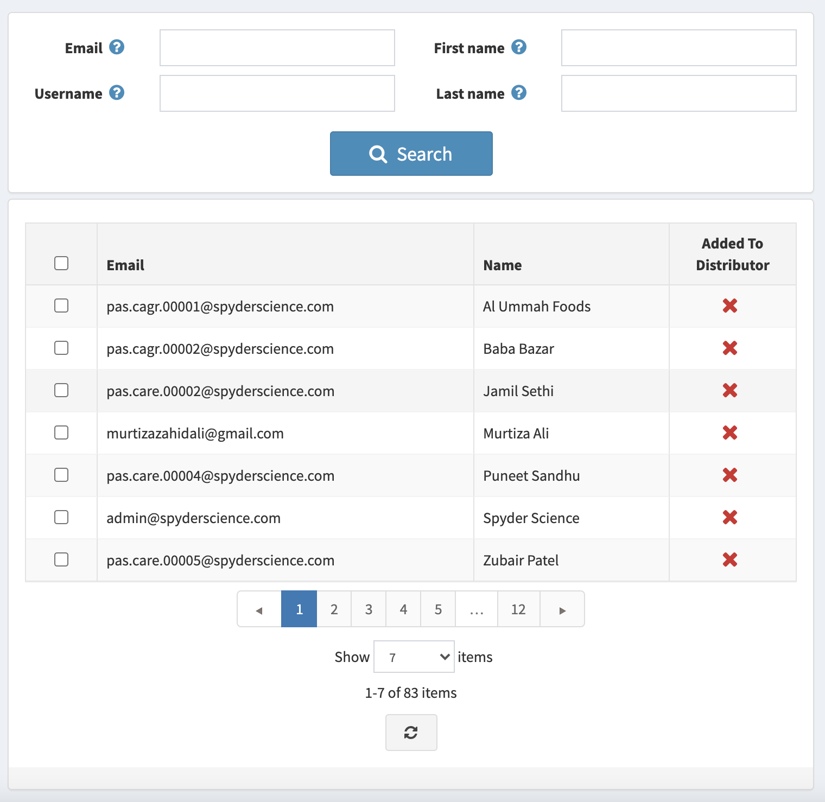
When “Assign” button is clicked on page 7 by a customer with Delivery Boy Manager Role, this pop-up will be opened. Only one customer can be selected. Here only those customers are shown that are permitted as Delivery Boys.
Choose Delivery Driver
Assign
Name
Mobile #
Address
Assigned
Customer 1
Mobile #
Address
Customer 2
Mobile #
Address
Customer 3
Mobile #
Address
Customer 4
Mobile #
Address
Customer 5
Mobile #
Address
Customer 6
Mobile #
Address
Customer 7
Mobile #
Address

Slide 19
When Detail button is clicked on page 11, this detail page will be shown. There is UTC Time in database but on admin side this should be changed to local timezone
Delivery Orders Detail – Order # 12323
Save
Order #
AssignedStatus
Vendor
ReadyToDrive
Store
ParkedAtStore
Warehouse
CollectedItems
# of Items
ReadyToDrive
Driver Earnings
ParkedAtCustomer
Assigned To
Delivered
Remaining Pickup
Time
SP_DeliveryUTC
Id | OrderId | VendorId | WarehouseId | AssignedStatusUTC | ReadyToDriveUTC | ParkedAtStoreUTC | CollectedItemsUTC | ReadyToDriveUTC | ParkedAtCustomerUTC | DeliveredUTC
1 | 23 | 32 | 25 | UTC TIME | UTC TIME | UTC TIME | UTC TIME | UTC TIME | UTC TIME | UTC TIME
2 | 43 | 23 | 11 | UTC TIME | UTC TIME | UTC TIME | UTC TIME | UTC TIME | UTC TIME | UTC TIME
3 | 43 | 23 | 12 | UTC TIME | UTC TIME | UTC TIME | UTC TIME | UTC TIME | UTC TIME | UTC TIME

Slide 20
Delivery Charges are already calculated using delivery plugin. Here we calculate driver and company income
Driver And Company Earnings Formula:
[OrderDelayCharges] = (MATH.ABSOLUTE([OrderPreparationTime] - [OrderCompletionTime]) / [OrderPreparationTime] )*[ODC]
[TotalEarnings] = [DELIVERY CHARGES] + [CheckoutAttributesAmount] + [VendorProfitRatioEffect] + [OrderDelayCharges]
[DriverEarnings] = [DC0]*[DELIVERY CHARGES] + [CheckoutAttributesAmount] – [ServiceCharges] + [OD0]
If [DriverEarnings]/[DistanceBetweenWarehouseAndShippingAddress] < [D0] {
[DriverEarnings] = [DELIVERY CHARGES] + [CheckoutAttributesAmount]
}
[CompanyEarnings] = [TotalEarnings] - [DriverEarnings]
[DC0], [ODC] and [D0] are constants defined on slide 6

